Slide 1







Exploratory Data Analysis and Predictive Modeling with Synthetic Splicing Dataset
Ajith Kumar Kannan

Slide 2
Background
Gene splicing: removal of introns and joining of exons.
Importance: creating functional mRNA for protein translation.
Goal: Analyze relationships between splicing factors and splicing events.

Slide 3
Dataset Overview
Data: splicing_data.csv
100 subjects, 5 variables:
1. SubjectID
2. SplicingFactor1, SplicingFactor2, SplicingFactor3
3. SplicingEvent (response variable)

Slide 4
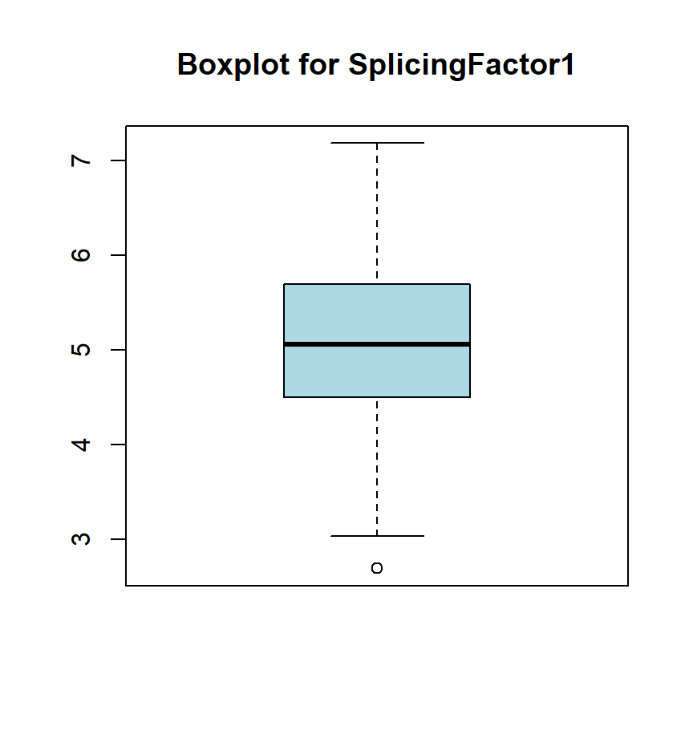
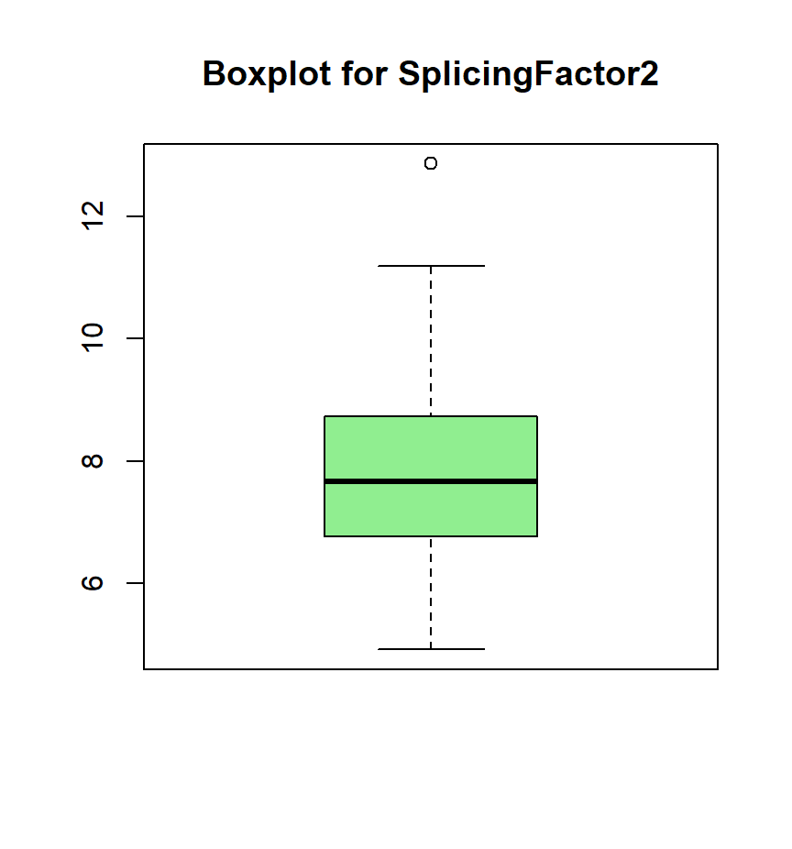
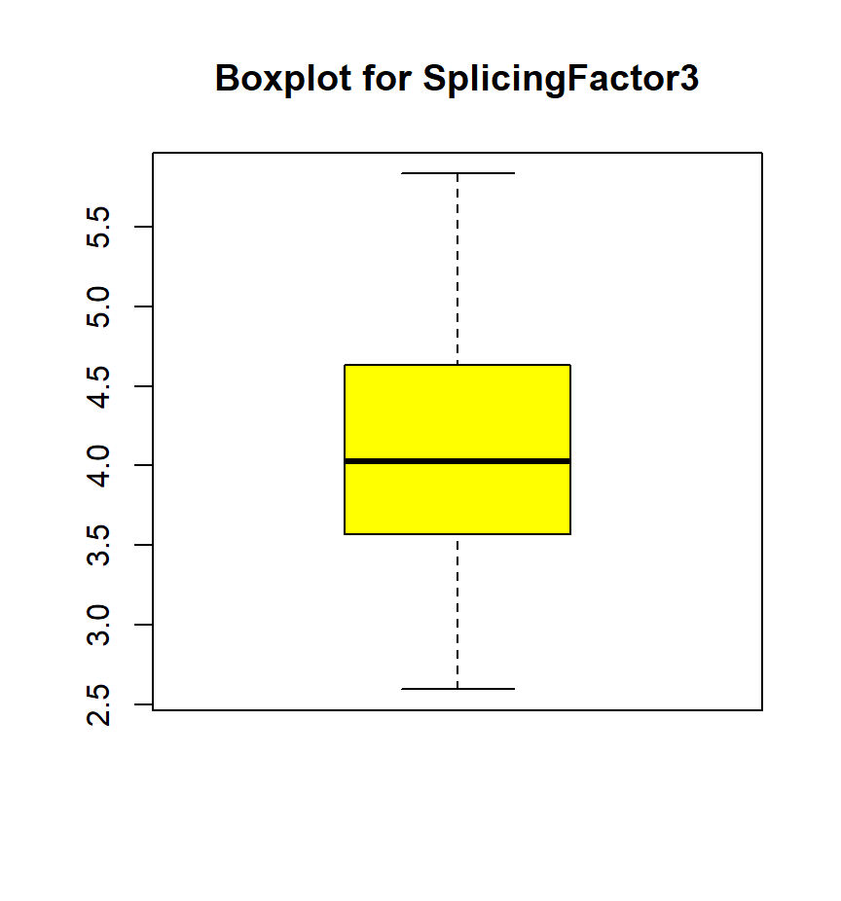
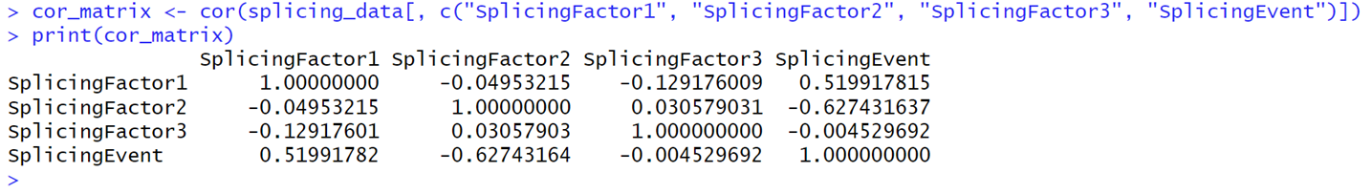
Exploratory Data Analysis
Summary statistics:
No missing values.
Outliers in Splicing Factors 1 and 2.
Normality and variance checks:
Left-skewed distribution for Splicing Event.
Variances acceptable for linear modeling.
Strong correlations between Splicing Factors 1 and 2 with Splicing Event.

Slide 5
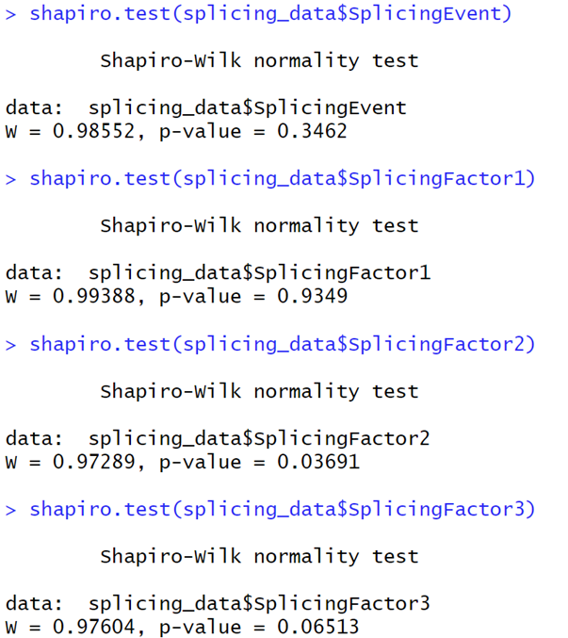
Shapiro-Wilk
p-value > 0.05: Indicates a normal distribution.
Results:
Splicing Event: p = 0.3462 → Normally distributed.
Splicing Factor1: p = 0.9349 → Normally distributed.
Splicing Factor2: p = 0.03691 → Not normally distributed.
Splicing Factor3: p = 0.06513 → Approximately normal.

Slide 6
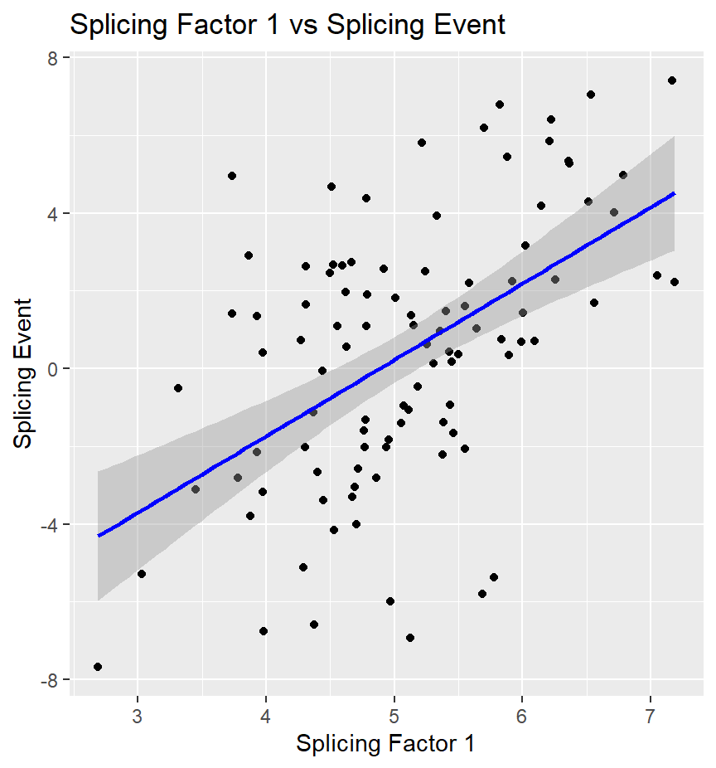
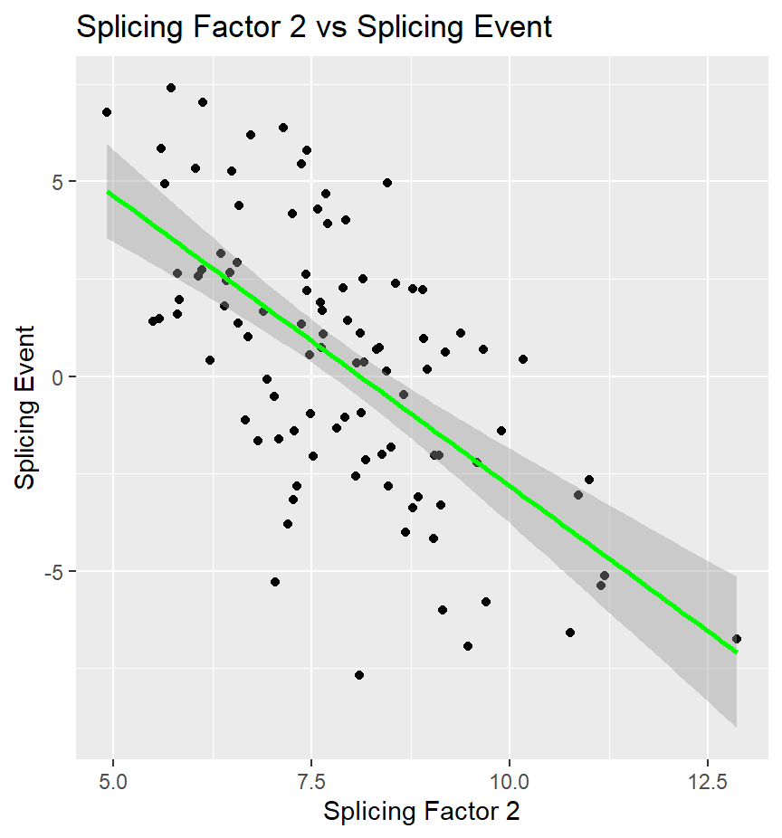
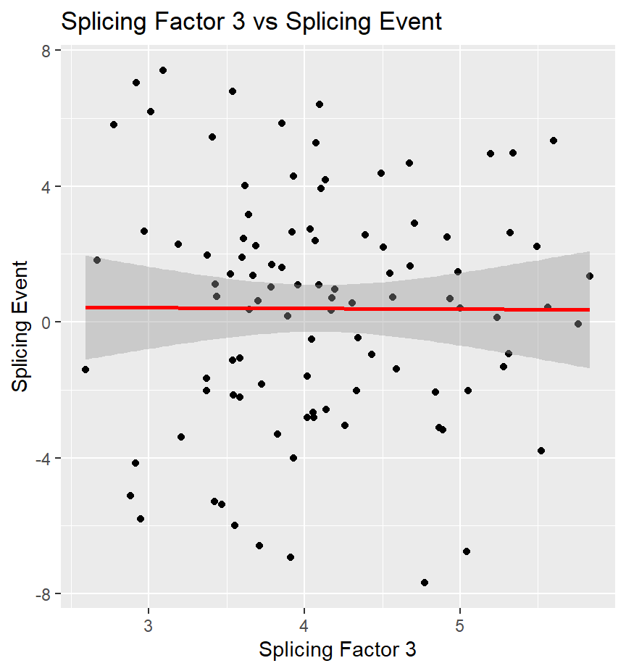
Data Visualization
Histograms for Splicing Factors and the Splicing Event.
Scatter plots with regression lines for:
1. SplicingFactor1 vs. SplicingEvent.
2. SplicingFactor2 vs. SplicingEvent.
3. SplicingFactor 3 vs SplicingEVent.

Slide 7
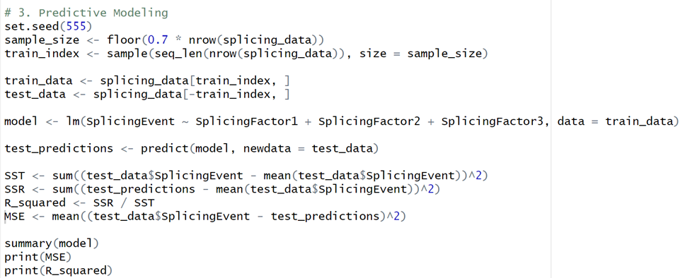
Predictive Modeling Approach
Model: Linear regression
Training (70%) and testing (30%) split.
Formula: SplicingEvent ~ SplicingFactor1 + SplicingFactor2 + SplicingFactor3

Slide 8
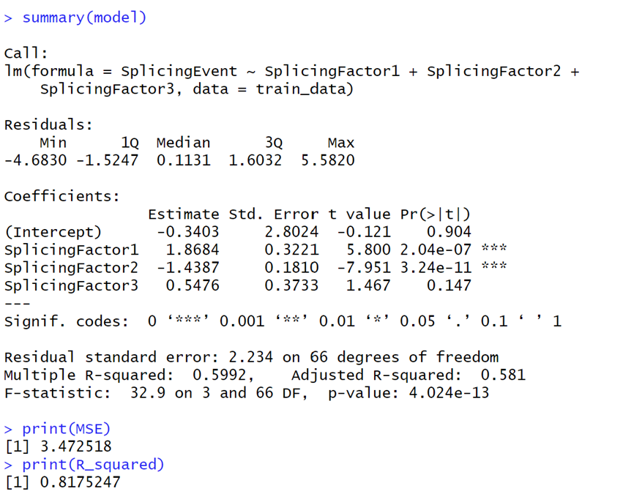
Model Results
Multiple R-squared (Training Data): 59.92%
R-squared (Test Data): 81.75%.
Mean Squared Sum (Test Data): 3.47

Slide 9
Key Findings
SplicingFactor1 (Positive Association):
Coefficient: 1.87 (p < 0.05).
SplicingFactor2 (Negative Association):
Coefficient: -1.44 (p 0.05).
SplicingFactor3 (No Significant Association):
Coefficient: 0.55 (p = 0.147).
Weak effect and statistically insignificant.

Slide 10
Recommendations and Conclusion
Explore interaction effects between factors (e.g., SplicingFactor1 × SplicingFactor2).
Test model on new datasets for generalizability.
Add new predictors (e.g., gene expression, environmental factors).
The model provides a solid foundation for understanding splicing factor impacts but needs further validation and exploration.

